Slide 2
The External Economic Action of the European Union and the Sustainable Development Goals
Filippo Fontanelli – University of Edinburgh – filippo.fontanelli@ed.ac.uk
University of Bologna
3 May – 25 May
5 May 2023
Cracks in the system(s)

Slide 3
Outline of the module (in progress)
The course’s basic coordinates
  Trade law, investment law and sustainable development: basic notions
  EU competences and policies in trade and investment law
Trade/investment obligations and non-trade values: the return of unilateralism
  The backlash against investor-State arbitration.
  The backlash against trade liberalisation
  Reform proposals for the global investment and trade regimes
  An overview of re-nationalisation trends in trade an investment (US, EU, UK, China)
    Anti-coercion
    Anti-circumvention
    Retaliate against non-MPIA
    Steel row, now sustainable
EU’s external economic action to raise standards abroad
  Free trade agreements and non-economic standards
    Conflict mineral regulation (sort of like diamonds)
    2022 commitment to green trade partnership
    Deforestation MERCOSUR
  Zoom-in: EU dispute with Korea on labour rights
  Zoom-in: level playing field and sustainable development in the Trade and Cooperation Agreement between the EU and the UK
    Mirror clauses
The Carbon Border Adjustment Mechanism
  Overview and assessment of the scheme
  Compatibility with WTO law (China’s complaint at WTO)
  Bonus: carbon removal
Energy (trade)
  EU Net Zero Industry Act and support to renewable energy industry (with assessment of WTO compatibility)
  Reaction to comparable foreign plans (US IRA)
  Zoom-in: biofuels and e-fuels
Energy (investments)
  Foreign investment protection and the fossil fuels industry
  Foreign investment protection and the nuclear energy industry
  Foreign investment protection and the renewable energy industry
  The Energy Charter Treaty, its reform attempts and the withdrawal of EU MS
Controlling trade and investment inbound and outbound flows
  Export restrictions and export controls (including coordinated action with US)
  Critical Raw Materials Act
  EU investment screening
Improving supply chains’ sustainability
  Friend-shoring and sustainable value chains
  Global supply chain due diligence proposal
  EU Guidance to Combat Forced Labor in Supply Chains
  Responsible forestry proposal (trade in forest-risk commodities)
  WTO law-compatibility of these schemes
Promotion of other social interests
  Non-paper of the Commission services 2017 TSD chatpers
  Gender balance in corporate governance in FTAs
  Protection of indigenous peoples’ rights
UNA Europa presentation

Slide 4

Presentations?
For last session, or thematic input into sessions 3 to 8.
Just drop me an email at filippo.fontanelli@ed.ac.uk

Slide 5



Cracks in the system
Reforms and proposals
The law of the jungle
Backlash against trade law
Backlash against investment law
UNA Europa presentation

Slide 6
Investment law and arbitration – the accusations
Substantive law
Arbitration

Slide 7

Substantive law
Vague provisions
Lack of exceptions
One-sided obligations
Damages
UNA Europa presentation

Slide 8
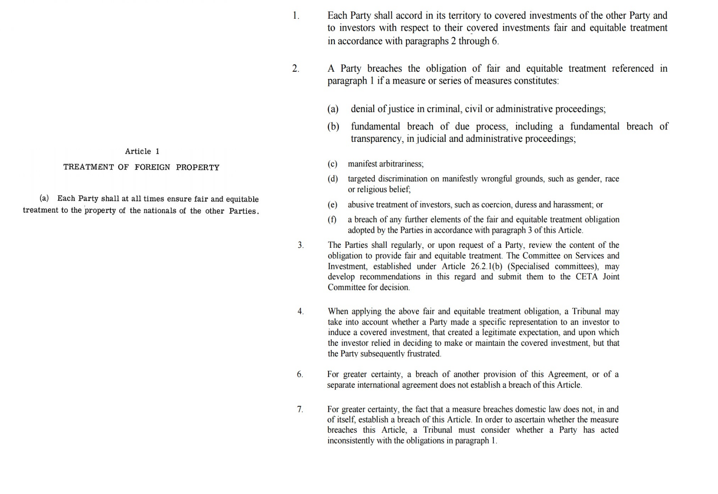
OECD Convention 1967
CETA 2016

Slide 9
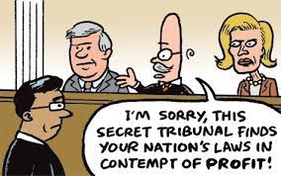
Arbitration
Incoherence without appeal
Lack of precedent
Biased arbitrators
No code of conduct
III party funding
UNA Europa presentation

Slide 10

Backlash against investment law and arbitration – the baseline
Rich states are on the ropes.
Regulatory activities must be carried out
with caution
Liabilities are huge
(not really helpful to attract $?)

Slide 11
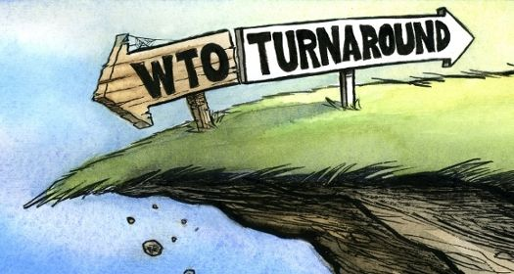
Trade law and dispute settlement – the accusations
Substantive law
Dispute settlement

Slide 12
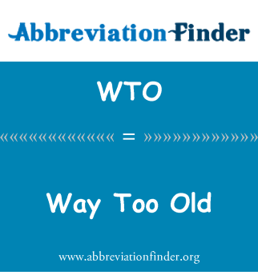
WTO law
Impossible to change laws (consensus)
General disenamouring with free trade
Impossible to rein in China’s industrial policies
UNA Europa presentation

Slide 13
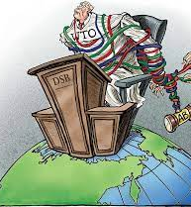
Dispute settlement
Too little too late
Too slow
Appellate Body running wild
US: breach of social compact
Lack of teeth (now in particular)
UNA Europa presentation

Slide 14
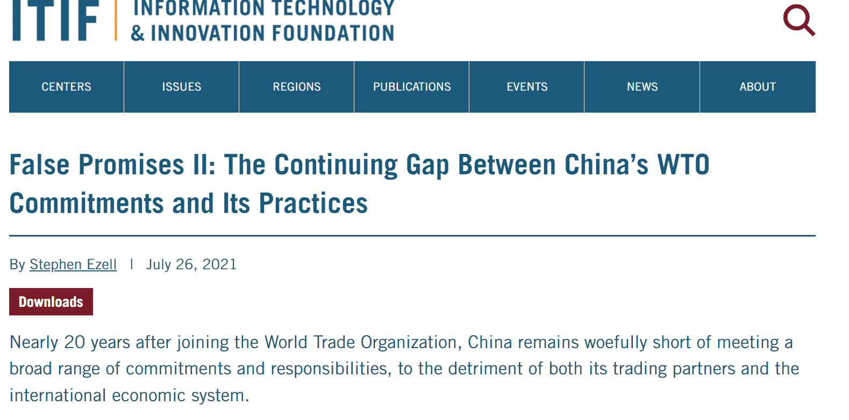
Backlash against international trade law – the baseline

Slide 15


Slide 16
Reforms
Investment law
Trade law

Slide 17
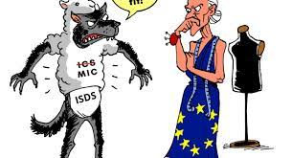
Investment law
ICS system in EU agreements
Re-write ECT
Multilateral Investment Court
Code of Conduct
New drafting trends
Transparency
Withdrawals
Regulating III party funding
UNA Europa presentation

Slide 18

Trade law
Change WTO’s focus (fisheries, fossil fuels)
Use FTAs instead
MPIA attempt to bridge AB gap
Other attempts... (trilateral on subsidies, etc)
https://onlinelibrary.wiley.com/doi/pdf/10.1111/cwe.12378
UNA Europa presentation

Slide 19
Towards a no-rule environment (i)
Resistance within EU: ISDS is illegal
Cosequences? Spain told WB it won’t pay awards.
Revision, withdrawal, avoidance of new rules, for instance in FTA
TTIP faltered

Slide 20
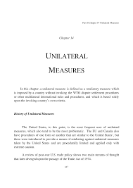
A no-rule environement (ii)
US use of Section 232 tariffs (security)
US’s attach to China on IP theft
US boycott of AB
General adoption of unilateral rules for COVID and war in Ukraine
IRA granting tax relieve for local products
UNA Europa presentation

Slide 21
The EU?
Arming up to face the challenge. For instance: ready to retaliate unilaterally against unimplemented (and appealed panel reports)
Escalation: India promised to fire back

Slide 22
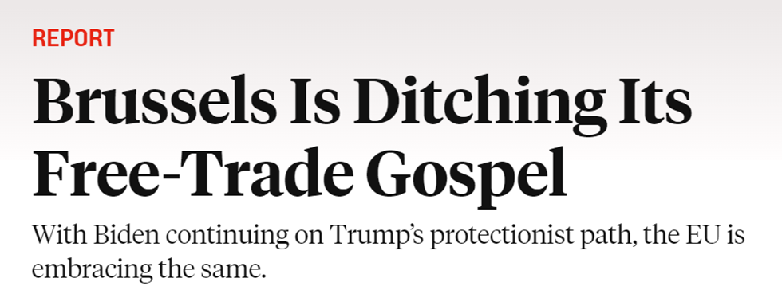
A no-rule environement (iii – the EU)
Our state aid frameworks exist to preserve our precious Single Market. But if investments in strategic sectors leak away from Europe, this would only undermine the Single Market. And that is why we are now reflecting on how to simplify and adapt our state aid rules.
https://ec.europa.eu/commission/presscorner/detail/en/speech_22_7487
https://foreignpolicy.com/2022/12/08/eu-brussels-free-trade-protectionism-electric-cars/
UNA Europa presentation

Slide 23
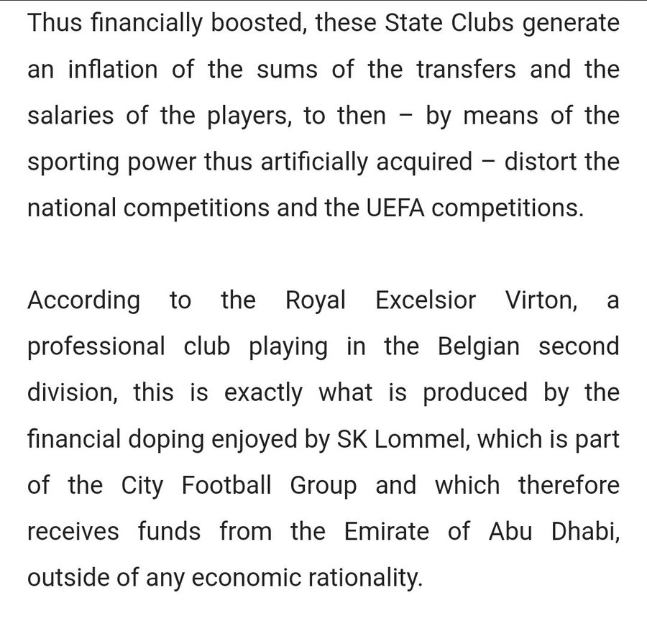
A no-rule environement (iv – the EU)
Anti-coercion (sec 301)
Foreign subsidies
Filtering investment
Retaliate against non-MPIA
Chips act
Steel pact with US
UNA Europa presentation

Slide 25
@una_europa
#Una_Europa
Thanks!

